Slide 1
Computer Network
IP Address

Slide 2
IP Address
An IP Address is a numerical label assigned to each device (Ex – Computer, Printer) to participating in a network that uses the internet protocol for communication. An IP Address serves two principal function:
Host or Network interface identification
Location Addressing
An IP address is a unique global address for a network interface.
IANA (Internet Assigned Numbers Authority) is responsible for global co-ordination of the Internet Protocol addressing systems.
IP is stands for Internet Protocol

Slide 3
IP Uses
Used to connect another Computer.
Allows to transfer files and emails.

Slide 4
Purpose of IP Address
The Internet Protocol defines the basic unit of data transfer (IP Datagram)
IP software performs the routing function.
IP includes a set of rules that process the idea of unreliable packet delivery.

Slide 5
IP Address Versions
IP Version 4
IPv4 was initially deployed on 1983 and is still the most commonly used version
An IPv4 is a 32-Bits Address.
Example: 192.168.0.10
IP Version 6
IPv6 protocol was developed by Internet Engineering Task Force (IETF) in 1999.
An IPv6 is a 128-Bits Address.
Example: 2001:0db8:0000:0042:0000:8a2e:0370:7334

Slide 6
IPv4 Address Structure
An IP Address consist of 4 Sections.
Each section is 8-Bits long
Each section can range from 0 to 255
Example:
192.168.10.15
1100 0000 . 1010 1000 . 0000 1010 . 0000 1111
Dotted Decimal Notation
Binary Notation

Slide 7
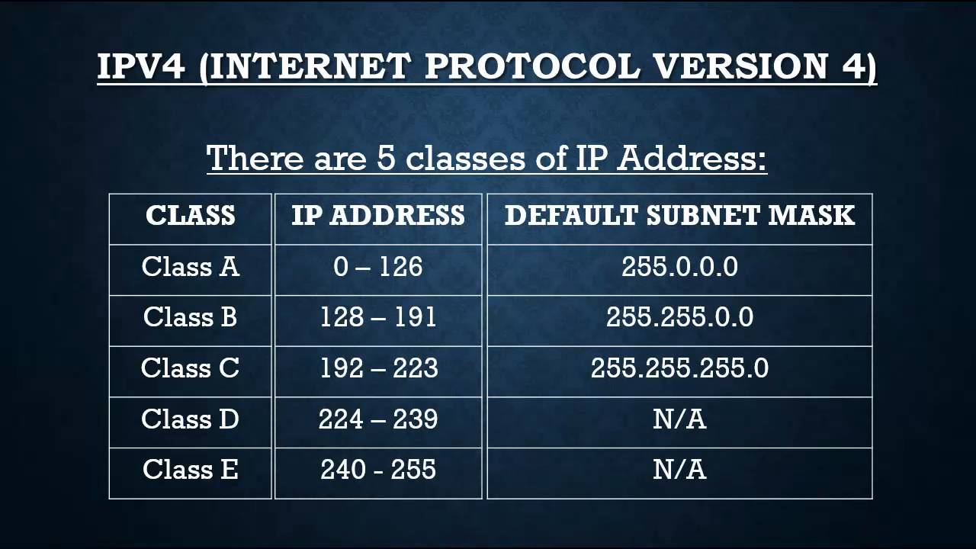
Classes of IPv4 Address

Slide 8

Class A
Class A addresses are assigned to networks with a very large number of hosts
The high-order bit in a class A address is always set to zero.
The next seven bits (completing the first octet) complete the network ID.
The remaining 24 bits represent the host ID.

Slide 9

Class B
Class B addresses are assigned to medium-sized to large-sized networks.
The two high-order bits in a class B address are always set to binary 1 0.
The next 14 bits complete the network ID.
The remaining 16 bits represent the host ID.

Slide 10

Class C
Class C addresses are used for small networks.
The three high-order bits in a class C address are always set to binary 1 1 0.
The next 21 bits complete the network ID.
The remaining 8 bits represent the host ID.

Slide 11
Class D & E
Class D addresses are reserved for IP multicast addresses.
The four high-order bits in a class D address are always set to binary 1 1 1 0.
The remaining bits are for the address that interested hosts recognize.
Class E is an experimental address that is reserved for future use
The high-order bits in a class E address are set to 1111.

Slide 12
Features of IPV4
Connectionless protocol and best effort based.
Simplicity
It is simpler and easy to remember
Require less memory
Familiarity
Millions of devices are already knowing it
Existing infrastructure already support it

Slide 13
Benefits of IPV4
Widely support
Shorter
Support of all Operating Systems
All commonly used protocols are supported

Slide 14
Types of IP Address
Static IP
Dynamic IP

Slide 15
Static IP
The static IP addresses usually never change but they may be changed as a result of network administration. They serve as a permanent Internet address and provide a simple and reliable way for the communication.
Manually input by network Administrator.
Manageable for small network.
Requires careful checks to avoid duplication.

Slide 16
Dynamic IP
Dynamic IP address are the second category. These are temporary IP addresses. These IP addresses are assigned to a computer when they get connected to the Internet each time. They are actually borrowed from a pool of IP addresses, shared over various computers.
Assigned by Server when Host Boots.
Derived automatically from a range of IP Addresses.
DHCP (Dynamic Host Configuration Protocol) responsible for providing IP Addresses.

